Slide 1
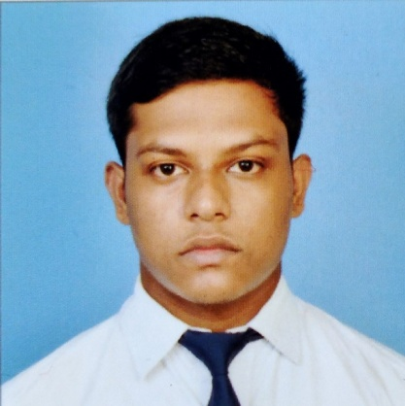



Somnath Roy
Analyst/Software Engineer
Bachelor of Technology in Electronics and Communication Engineering : 2018 - 2022
Skills
Java 8 /J2EE | Java Basics, OOPS, Generics, Collections, Arrays, Loops, Lambda Exp, Stream API Junit, Mockito, Servlets
Spring core | IOC & Dependency Injection, Autowire
Spring REST | REST controllers, Implementation of GET, POST, PUT & DELETE, Bean Validation & Exception Handling, Testing Services, Controller & Repository layer
Spring Data JPA | Implement DAO layer using spring Data repositories, Transaction Management
Spring Boot Microservices | Spring Boot Starters, annotations, Messaging Service, Sync/Async comms, Swagger API documents
Spring Cloud | Eureka, Netflix Ribbon, Feign Client, Netflix Hystrix, Netflix Zuul & Config Server
React | Components, Hooks, Event handling, Redux, Reducers, Testing using Jasmin & Karma
Database | MongoDB No Sql Basics My SQL RDS Basics
UI Tech | HTML 5 & CSS 3,JavaScript, ES6 & TypeScript Reusable templates, Optimized UI Designed
Tools | Git, Postman, Maven, IDE
Add On skills | Communications, Team management. Peer learning
Mumbai
SOMNATH.A.ROY@CAPGEMINI.COM
+91 8334059363
A4
Full Stack Developer
Hands on experience in creating microservices with Springboot, Spring Security, Spring Cloud API Gateway, Eureka server.
Hands on experience in implementing polyglot architecture with NodeJs & spring boot
Hands on experience in creating documentation with swagger and in unit testing using Junit, Mockito.
Development experience using Eclipse, intellij, VS Code, pgAdmin for postgreas, postman Api connection and MangoDB by AtlasI
Hands on experience in building web pages using HTML, CSS, Bootstrap, React.
Coupons and deal finder Application
Completed end to end case study of Coupon Finder Application along with JWT authentication, Swagger documentation and payment integration with testing using Junit and mockito, responsive UI with Material UI and ReactJS used for user interface, Database used is Mongo Db Atlas.
Faculty Management System
Completed end to end case study of Faculty Management System using HTML 5, CSS 3 with bootstrap 4, JavaScript ES6, PostgreSQL, React js, Redux, Typescript, Git.
Check out my work on GitHub & Video Profile

